Slide 1




ANALYSING INFLATION AND RECESSION IN THE UK: UNDERSTANDING PATTERNS AND EFFECTS
This presentation aims to provide a comprehensive analysis of recession and inflation patterns in the UK, emphasizing their impact on economic stability and policy decisions. Through advanced software analysis and data visualization, we explore the interconnectedness of key economic indicators and the challenges associated with economic instability.
by Namrata Diwate

Slide 2
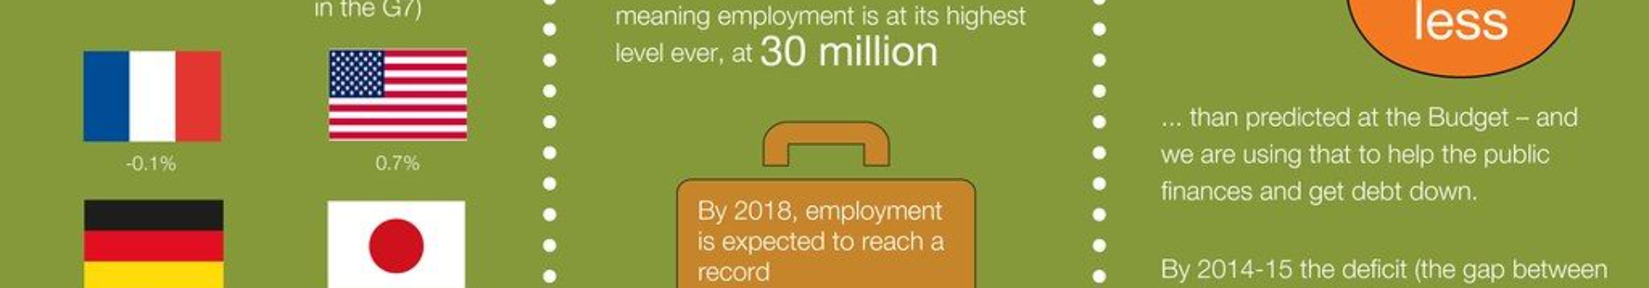
Outline and Introduction
1
Introduction to Economic Stability
2
Focus on Recession and Inflation Patterns
3
Software Analysis Methodology
Offering a detailed overview of the UK's economic landscape, emphasizing the relevance of studying recession and inflation patterns.
Detailing the key economic indicators that will be explored and the importance of data visualization in this analysis.
Highlighting the methodology involved in the software analysis process, which will be pivotal in understanding the impact of economic instability.

Slide 3

Research Gaps and Motivation
Research Gaps
Motivation
Limited resources on the causes of recession and inflation patterns, and the pressing need for a more in-depth analysis of UK financial sectors.
Emphasizing the significance of understanding economic stability for policymakers and the potential impact on policy decisions and economic strategies.

Slide 4
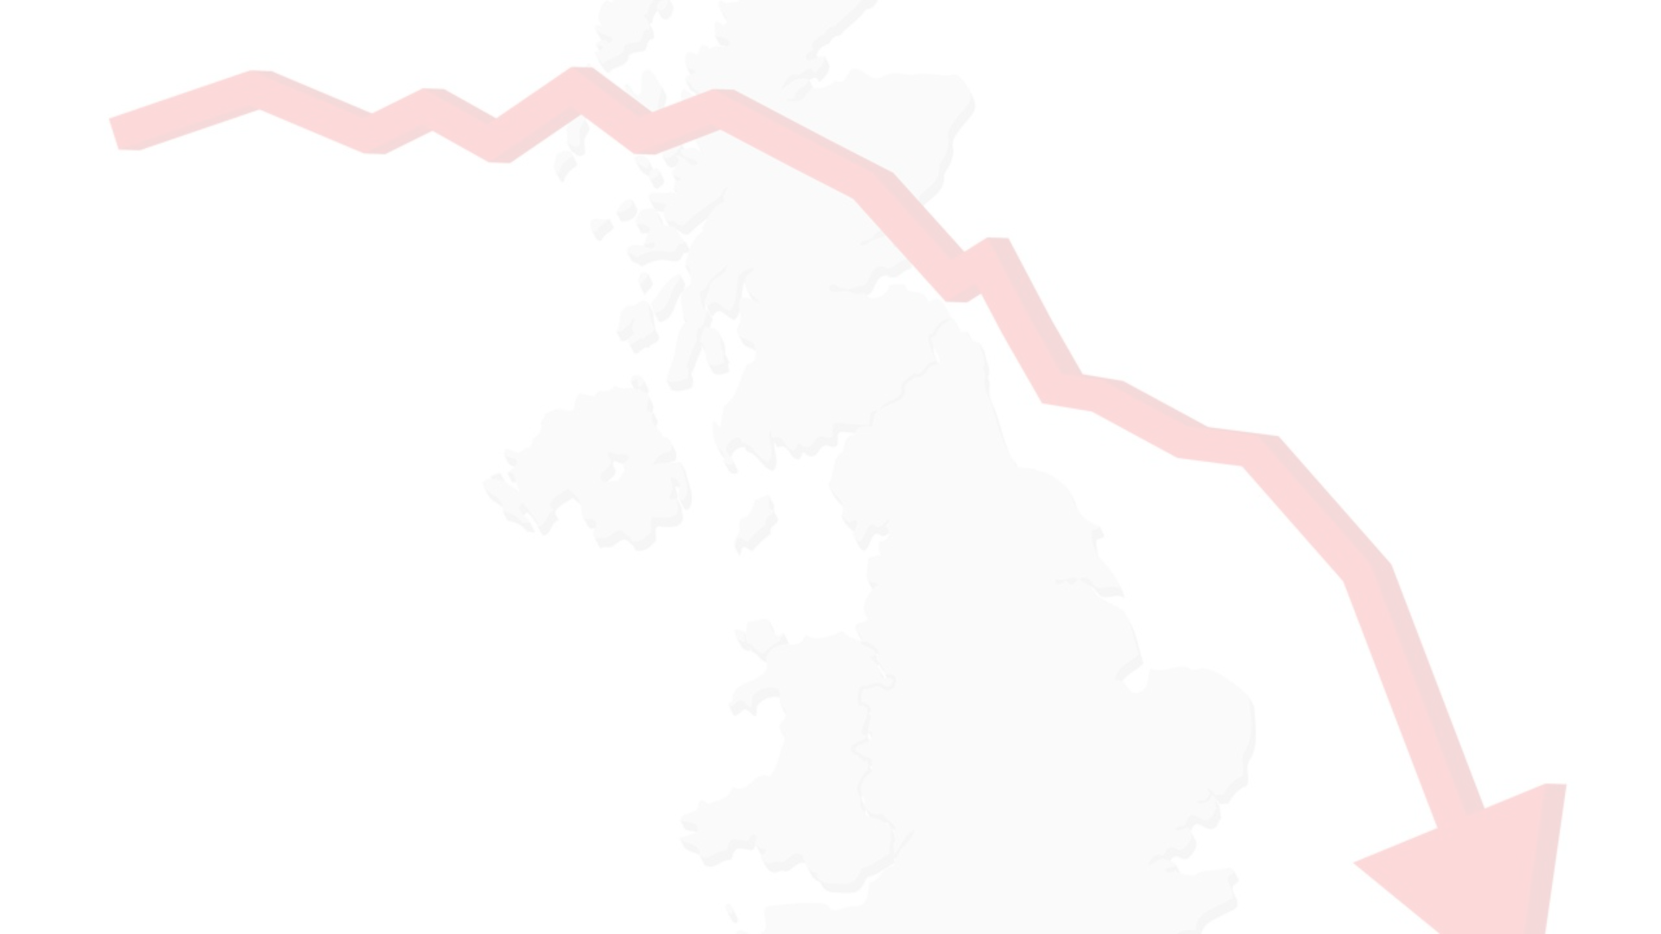
Problem Statement/Aim and Objectives
Problem Statement
Aim: Comprehensive Evaluation
Objectives
Addressing the economic instability arising from recession and inflation patterns.
Exploring recession and inflation patterns, evaluating software analysis functionality, examining key economic indicators, and providing strategic recommendations.
Striving to conduct a comprehensive evaluation of economic stability in the UK.

Slide 5
Implementation Modules
Data Preprocessing
Software Analysis
Describing the historical data examination, pre-recession and post-recession period analysis, and the approach to handling missing values and data standardization.
Discussing the visualization of economic data, the utilization of LSTM models for recession and inflation analysis, and the data processing functionalities.

Slide 6
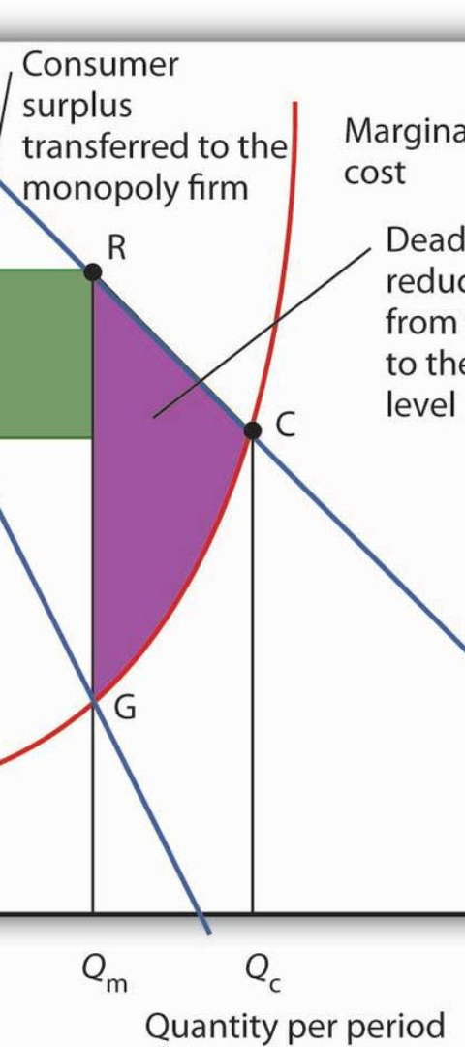
Results Demonstrating Whether the Objectives Were Achieved
1
Accurate LSTM Models
Successful development of LSTM models with 99.99% accuracy for recession and 96.25% for inflation analysis.
2
Visualization of Key Indicators
Demonstration of visualized key economic indicators including GDP growth, debt, and employment rate.
3
Correlation Analysis
Strategic identification of challenges associated with recession and inflation, with a focus on their causes and consequences.

Slide 7
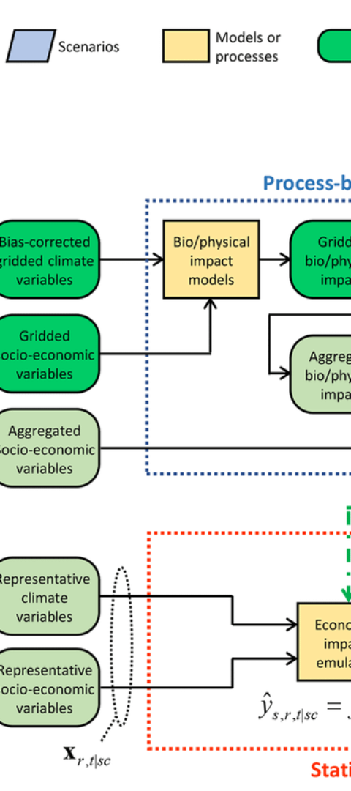



Conclusion
Summarized Findings
Summarizing key findings related to recession and inflation patterns in the UK.
Government and Economic Stability
Highlighting the impact of government expenditure, interest rates, and GDP growth on economic stability.
Global Interconnectedness
Emphasizing the interconnectedness of global events and the need for coordinated efforts between government and central banks.

Slide 8
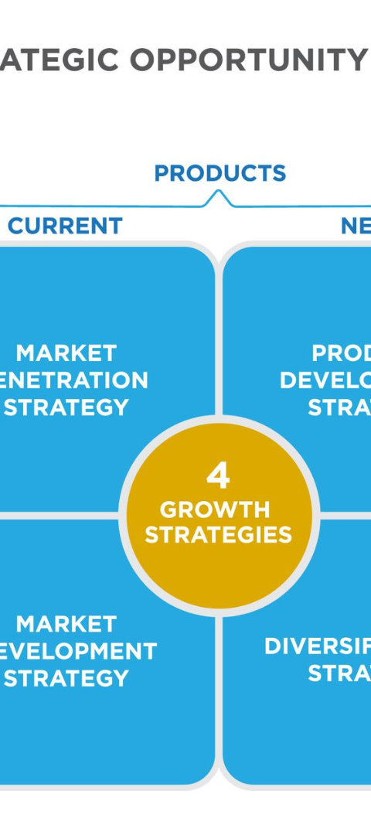
Significance for Future Researchers, Policymakers, and Other Stakeholders
1
Early Warning Systems
2
Informed Decision-making
Discussing the importance of early warning systems for economic weakness based on recession and inflation patterns.
Highlighting the capability of informed decision-making offered by the analysis to stakeholders.
3
Optimizing Strategies
Emphasizing the potential for optimizing strategies based on comprehensive inflation and recession pattern analysis.

